Slide 1
Our Student Council Year
By: The Student Council
Adelyn Isajiw - President
Alexis Pellak - Vice President
Carter Berardoni - Treasurer
AnnaBelle Bartley - Secretary

Slide 2
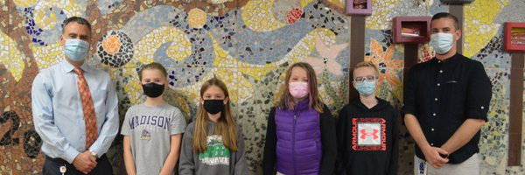
Our Vision Statement
Our student council is here to make every Manoa scholar feel like they belong and make them feel appreciated. We want to make sure they are encouraged to be their best selves so that they are able to have a great year. As student council, we are trying our best to make every scholar’s voice count. We want to not only make an impact in our school, but also in our community.
AI

Slide 3
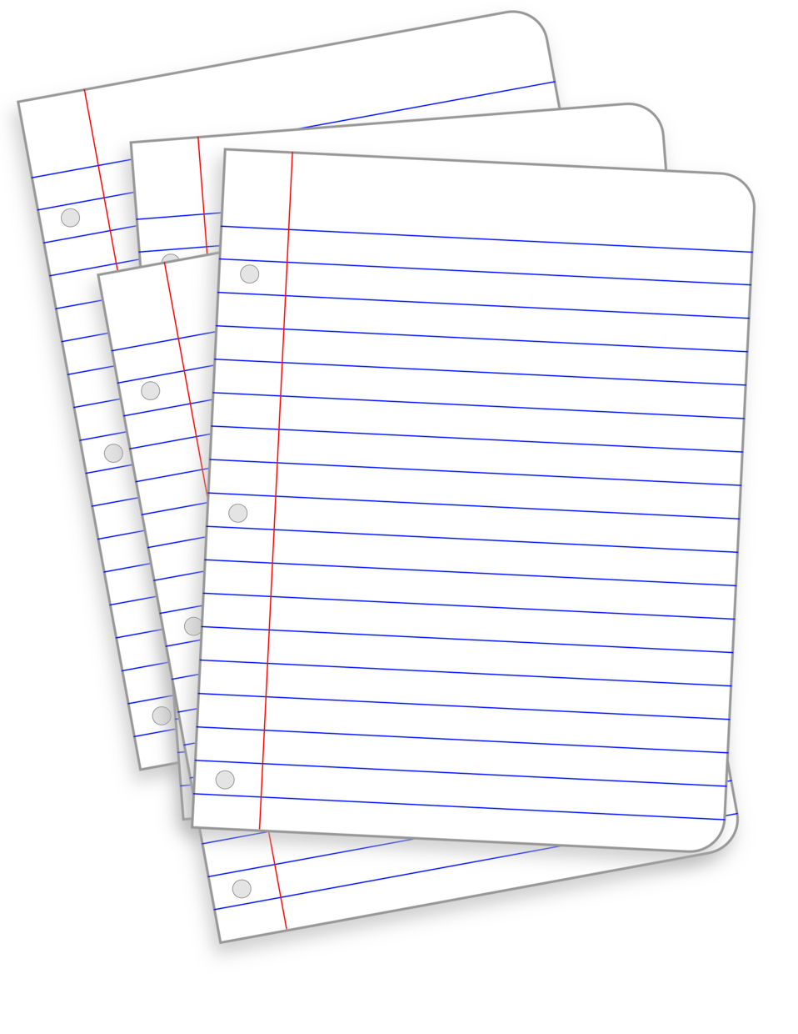
Meeting Guide
Our meetings occur twice a month. We have homeroom representatives in 4th and 5th grade. They come to meetings once a month and report ideas from their homerooms. Our other meetings are with Dr. Ramoundos and Mr. Quinn. We give them updates and ideas for them to approve.
AB

Slide 4
Current Projects
Bottle Cap E.C.O.P. Project
Book Swap/Read Across America
Magic Mailbox
Swing Set
Fundraisers

Slide 5
Swingset Project
We have ordered swings for the playground here at Manoa. A 3rd grader, Liam Reilly, presented this idea to the School Board because all of the other elementary schools in the district have swings. We polled all Manoa students for playground requests and swings were the most popular. Our goal is to make sure every Manoa scholar is happy, and by putting swings in, they will have something new to enjoy. We are very excited to finally have this project happening after years of asking. We think it will be life changing to the kids here.
CB

Slide 6
Bottle Cap Project
As you most likely know, we have been collecting bottle caps in hopes to reach our goal of 127 lbs, to purchase a bench. So far, we have about 78 lbs, and we hope to collect as many more as possible. Once we finish collecting, we will send the caps off to be melted into a new bench that we will put somewhere around the school. This initiative will help our environment and prevent plastic from ending up in the ocean. Thank you for donating!
AI

Slide 7
Our Meeting With Ms. Taddei
A lot of our student council meetings have revolved around lunch issues. Therefore, we set up a meeting with Ms. Taddei who is in charge of food services for the district. We discussed these issues and began working on solutions.
These issue include:
Sporks are a choking hazard
Not enough snacks to meet the demands
Food and beverage temperatures
Gluten free option require parent contact
More vegetarian food options
AB

Slide 8
Book Swap
We are collecting a book from each student this week. On Read Across America Day (March 2), students will get to browse the selection and choose a book. We will sort the books by levels and have a book for every student at an appropriate level of reading. Each student will get to take home a ‘new’ book! We are doing this to share our love of reading and recycle books instead of throwing them away.
LP
Notes:
Lexi

Slide 9
Magic Mailbox
This year, we have taken on the Magic Mailbox. Our Magic Mailbox is where students put donations in our office’s mailbox. Every two months we have a new charity. For January - February we were donating hats and gloves to Grands Stepping Up. For March, we are going to collect baby toiletries for Pathways P.A. Be on the lookout for a flyer about this!
LP
Notes:
Lexi

Slide 10
Fundraisers
Due to fact that we are spending a lot of the budget, we have been working on fundraiser ideas to earn back what we have spent. We would like to have a raffle table at some of your events. We would like to let you do your own festivals and events while still taking part in it all. Just having a table to run would be a huge help to us to replenish the budget. That way, we can make sure the student council next year can do as much to help Manoa and the community as much as we did. We’ll be in touch about some future opportunities.
CB

Slide 11
Thank You
Thank you PTO for all the support you have provided to the Student Council so far this year. Specifically, your funding of the recess equipment was very appreciated! We would be interested in working with you more before the end of the year! Thanks!

